Slide 1

Governors Making Use of Artificial Intelligence
Dave Cadwallader
School Governance Lead

Slide 2
What is AI?
AI is a machine’s ability to perform the cognitive functions we associate with human minds, such as:
perceiving
reasoning
learning
interacting with the environment
problem-solving
exercising creativity
Day-to-day examples include:
Siri
Alexa
Those pop-up chat boxes that ‘help’ to navigate websites

Slide 3
Popular AI Tools
Also:
Claude AI
Quillbot – text-based assistant
MidJourney – image generator
ChatGPT
Gemini (Google)
CoPilot (Microsoft)
Meta AI
Apple Intelligence

Slide 4
ChatGPT (Chat Generative Pre-trained Transformer)
ChatGPT is a ‘Chatbot’ - an AI-powered conversational agent developed by OpenAI
Fastest-growing app in history: 100,000,000 users within 2 months (2022)
‘Generative AI’ - the ability to produce new content in response to prompts
Assist with tasks such as: answering questions, generating ideas, offering explanations, and providing feedback
ChatGPT can be used in a wide range of educational contexts to support students, teachers, and governors

Slide 5
Support for Pupils
Homework assistance: pupils can ask for help with maths problems, historical facts, science concepts, etc
Research: AI can guide students to reliable sources and provide a foundation for research projects
Critical thinking: ChatGPT can pose questions that challenge students’ reasoning skills
Language practice: practical applications for MFL and EAL
24/7 remote tutoring

Slide 6
Support for Teachers
Lesson planning: tailored suggestions based on pupil’s needs
Assessment: supporting moderation
Grading work and providing personalised feedback
Suggesting resources and teaching materials
Generating ideas for classroom activities

Slide 7
Support for Governors
Drafting and reviewing policies
Preparing meeting agendas and minutes
GB panel outcome letters
Answering legal or procedural queries quickly

Slide 8
ChatGPT Potential Concerns
Data Privacy: interactions are in the public domain
Accuracy: not always perfect. Human oversight is essential
Bias: AI might reflect bias in its answers. Again, human oversight needed
Over-Reliance: ensuring that AI enhances learning and support, rather than replacing critical thinking and human interaction
Lack of Human Touch: AI may not be able to handle complex emotional issues
Ethical Considerations: may generate content that might be considered inappropriate if not monitored

Slide 9
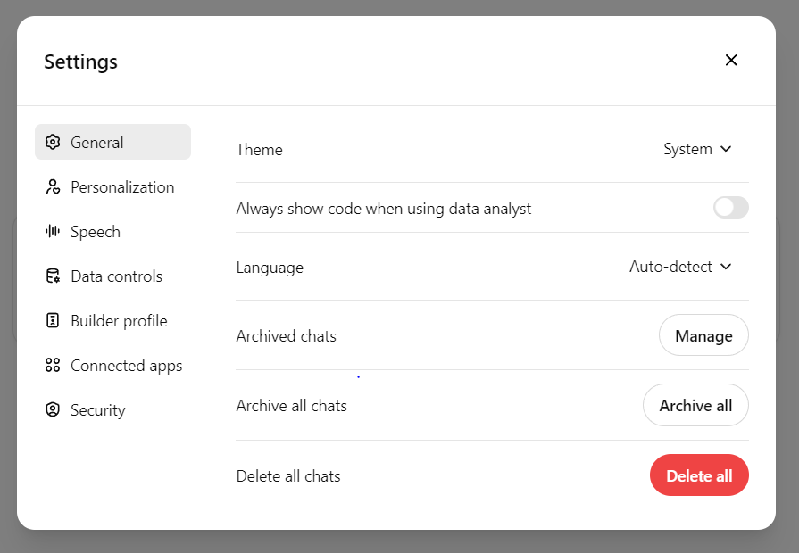
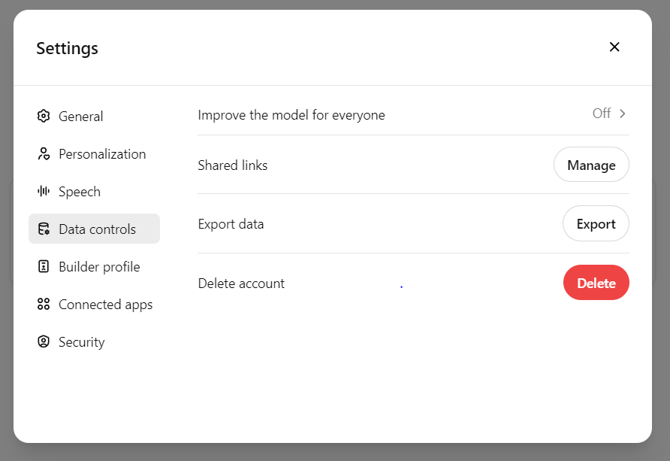
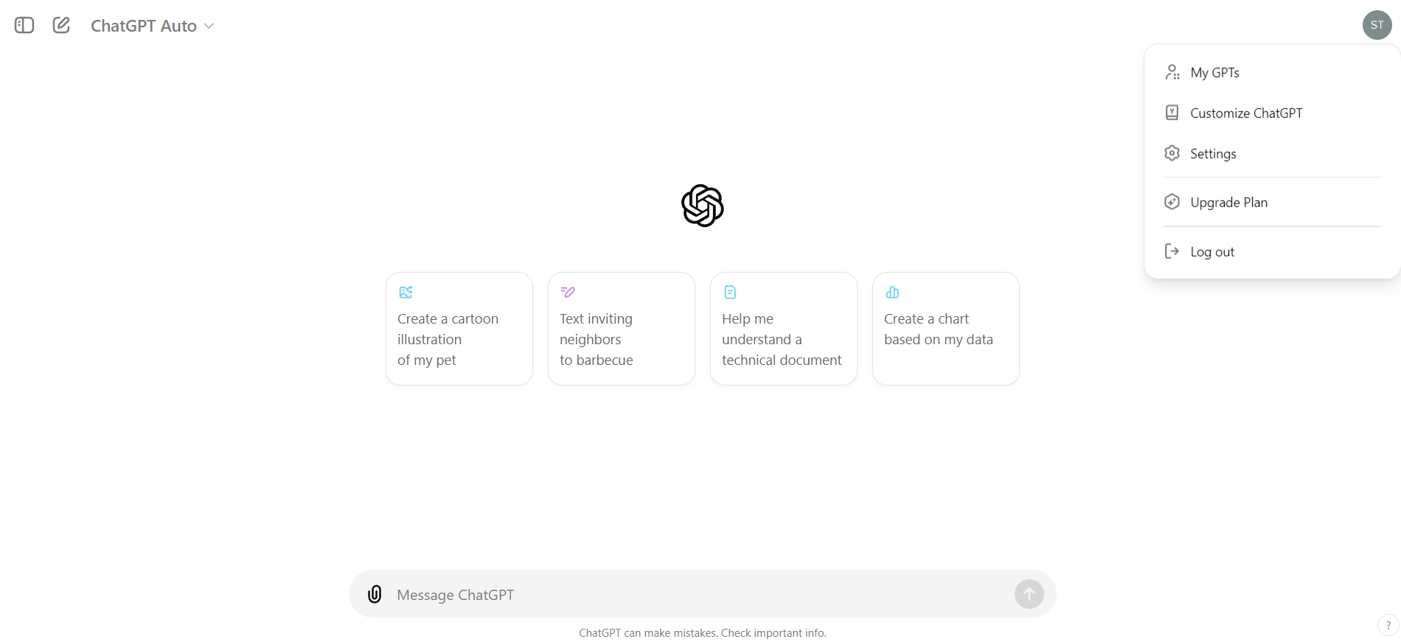
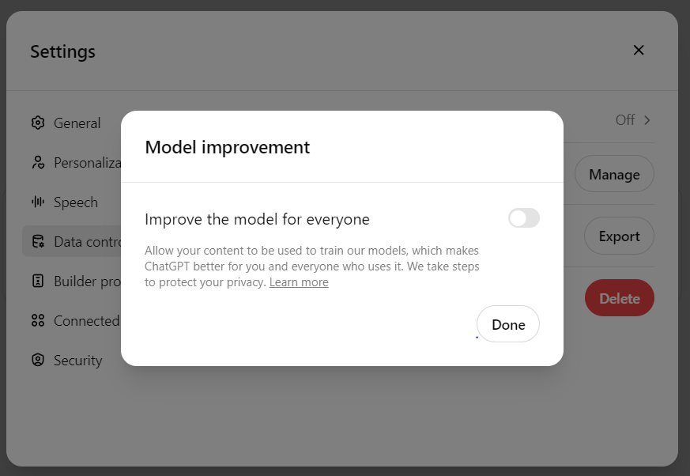
Disabling content collection on AI apps
Preventing GenAI tools from learning from the data you enter
Open ChatGPT and go to:
Your icon top right
'settings'
‘general’
‘data controls’
‘improve the model for everyone’
Disable
Click ‘done’
Notes:
Ensure you turn off the content collection feature built into tools such as ChatGPT. How to stop ChatGPT learning from the data you enter

Slide 10
Moving Forward
ChatGPT / AI is here to stay and will get bigger and better
ChatGPT / AI is a flexible and powerful tool that can support schools (and governors)
Governors have an opportunity to ensure their school is at the forefront of educational innovation
Need to consider carefully where AI can be utilised
Need to be aware of the potential drawbacks

Slide 11
Opening a ChatGPT Account
chatgpt.com
Email address – DOB – password
To disable content collection:
  Your icon (top right)
  Settings
  Data controls
  Disable ‘Improve the model for everyone’

